Slide 1
IBM Capstone final project
A recommendation engine for residential property location
20/04/2019

Slide 2
Introduction
Part 1: Problem Description
A property developer in one of the boroughs of Toronto (Scarborough) wants to know if this is the best area to construct residential properties. Based on her research, the contractor has specifications in terms of what her customers want. The research imply that 95% of potential clients have preferences and are most likely to purchase the property if these preferences are met.
Most buyers prefer a location which is closest to schools, libraries, church, hospital/clinic, transport, shops/stores and definitely far from pubs and clubs. So these are the most crucial aspects of the location that the contractor needs to identify before developing her property here

Slide 3
…..introduction
Part 2- Data
1- The project requires location information about that specific borough and the neighborhoods in that borough. We will need the coordinates of "Scarborough" in Toronto.The developer has specified that this is the location of interest. we will use postal codes that fall into that borough (Scarborough
2-we will use Foursquare geo location data capabilities to get the location data we are looking for. these data will provide all the information we need, from basic to detailed information.

Slide 4

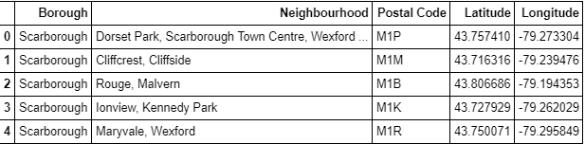
Methodology
Part 1: Identifying Postal Codes (and then Neighborhoods) in "Scarborough"

Slide 5
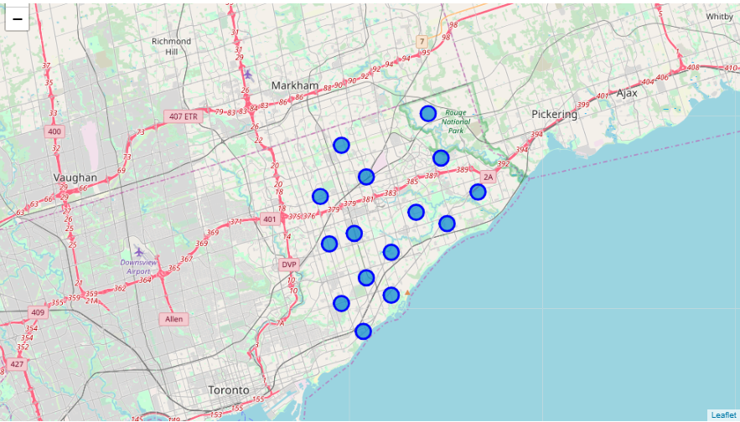
….Methodology
Part 1: Identifying Postal Codes (and then Neighborhoods) in "Scarborough“

Slide 6
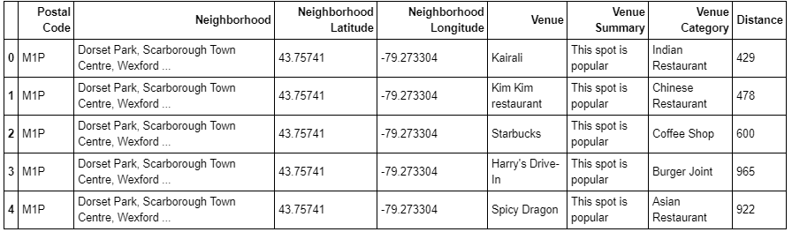
…methodology
Part 3: Processing the Retrieved Data and Creating a DataFrame for All the Venues inside the Scarborough¶

Slide 7
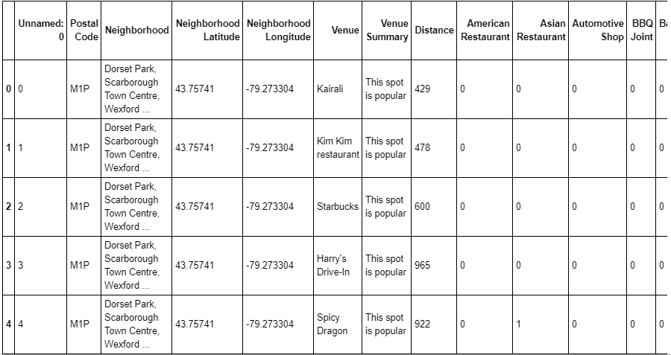
…methodology
The data was then hot-encoded to make it ready for machine learning

Slide 8
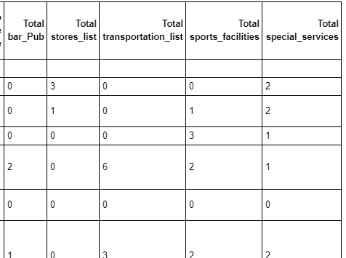
…methodology
The venues were grouped into categories based on their similarities

Slide 9
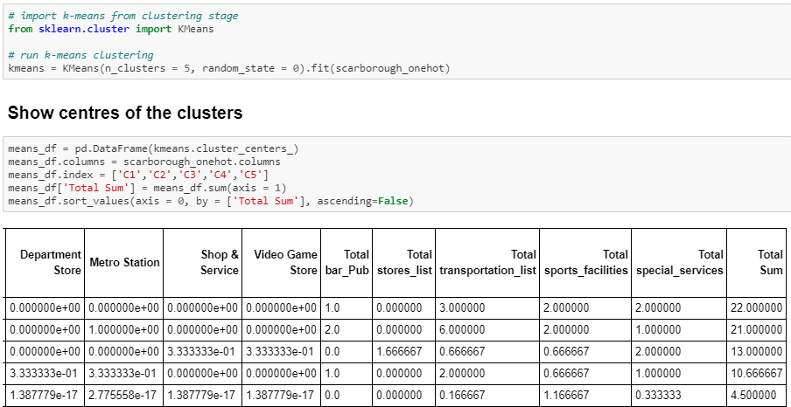
…methodology
Ran a K means clustering algorithm on the prepared dataset

Slide 10
Results and Conclusion
Now, we focus on the centers of clusters and compare them for their Totals per category. The group whose center has the highest "Total Sum" will be our best recommendation to the property developer. {Note: the Total of unwanted venues i.e. pub/club group decreases the likelihood of a neighborhood being chosen hence it will be deducted from the total}.

Slide 11
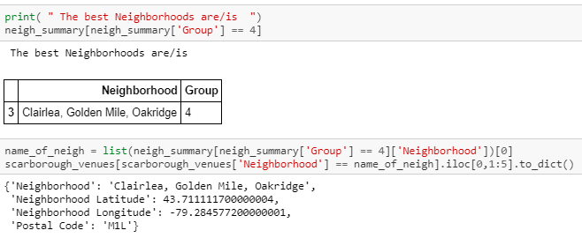
…results and conclusion
The best neighbourhood is: Clairlea, Golden Mile, Oakridge

Slide 12
…results and conclusion
Clairlea, Golden Mile, Oakridge is a neighborhood with the highest number of important venues and only one pub/club within 1000km radius of the ares of interest.

Slide 13
Thank you
P. Mthembu

